Slide 1
Congestive Heart Failure A basic science to clinical practice
Yuttapong Wongswadiwat, M.D.
Assistant professor, Division of Pediatric Cardiology, Department of Pediatrics
Faculty of Medicine, Khon Kean University
Lao Paediatric CME conference 2019
Vientiane Capital, Lao PDR
26 April 2019

Slide 2
Congestive heart failure (CHF)
Clinical state of systemic and pulmonary congestion resulting from inability of the heart to pump as much blood as required for the adequate metabolism of the body
Strictly related to age
Pathophysiology related to preload, afterload
contractility and heart rate
Management is an application of basic sciences to clinical practice

Slide 3
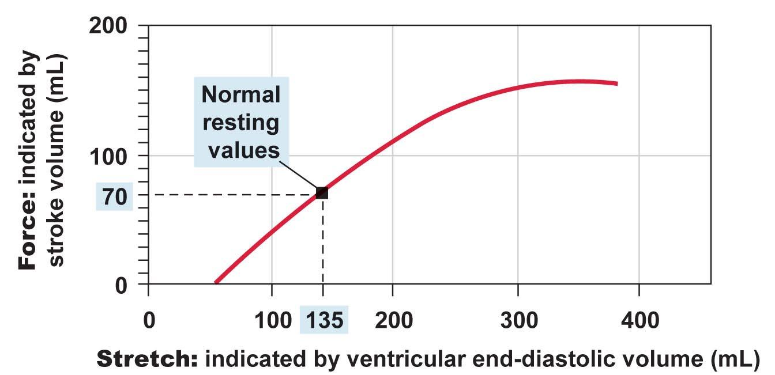
The Frank Starling mechanism
Clinical critical care medicine, Richard K. Albert et al. 2006

Slide 4
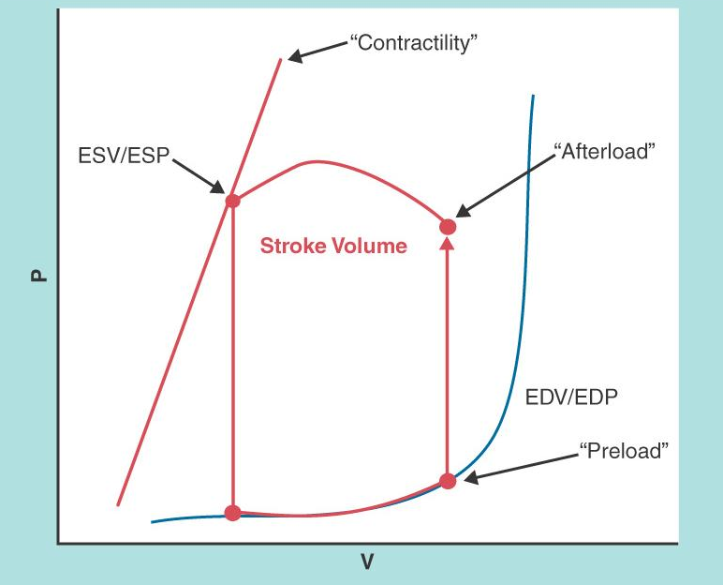
The Pressure volume loop of ventricles
Clinical critical care medicine, Richard K. Albert et al. 2006

Slide 5
Maximizing Oxygen Delivery
Cardiac
Output
Stroke
Volume
Heart
Rate
=
X
Stroke Volume
Contractility
Diastolic Filling
Afterload ( SVR )
Heart rate
Physiologic Response
Non-physiologic Response
Sinus vs. junctional vs. paced ventricular rhythm
Normal CI = 3.5 – 5.0 L/min/m2
NB CI = 1.7 – 3.5 L/min/m2

Slide 6
Pathophysiology of Heart Failure
Pediatrics and Neonatology (2017)58, 303e312 http://dx.doi.org/10.1016/j.pedneo.2017.01.001

Slide 7
Causes of CHF resulting from CHD
Age of Onset | Cause
At birth | HLHS Volume overloaded lesions: TR,PR Large systemic AV fistula
First week | TGA, PDA, HLHS, TAPVR, Systemic AV fistula Critical AS/PS
1-4 week | CoA with associated anomalies, Critical AS Large left to right shunt lesions(VSD,PDA)
4-6 week | Endocardial cushion defect
6 weeks-4 month | Large VSD, Large PDA, ALCAPA

Slide 8
Clinical Manifestations
In neonates and infants
Tachypnea, feeding difficulties, poor weight gain, excessive perspiration, irritability
weak cry and noisy, labored respiration
Hepatomegaly and Cardiomegaly
Tachycardia and gallop rhythm
Edema
Pallor and deep coloring

Slide 9
Clinical Manifestations
In Children
Fatigue, effort intolerance, anorexia,
abdominal pain and cough
Engorged neck vein, hepatomegaly and edema
Dyspnea, orthopnea and pulmonary rales
Cardiomegaly
Gallop rhythm

Slide 10
CHF in Neonates and Infants
Feeding difficulties and excessive sweating
Tachycardia >150/min is common
Mild-moderate-severe
feeding volume & time, RR, HR
Tachycardia, Tachypnea, Cardiomegaly
Hepatomegaly
Pathophysiology of symptoms

Slide 11
Heart Failure scores
MJAFI 2003; 59 : 228-233

Slide 12
CXR in congenital complete heart block with PPM

Slide 14
Treatment
The underlying causes
General measures
Diet : restrict, low salt, high calories
Digitalis
Diuretics : furosemide, spironolactone
Afterload-reducing agents
Adrenergic agonists
Phosphodiesterase inhibitors

Slide 15
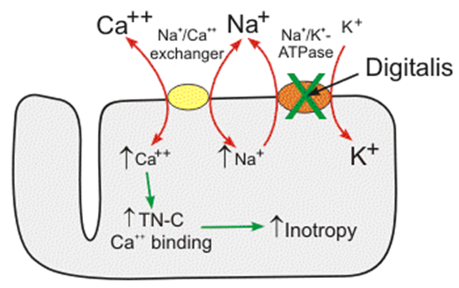
Mechanism of digitalis action
http://www.cvpharmacology.com/cardiostimulatory/digitalis.htm

Slide 16
Digitalis
Half life 36 hours (daily or twice daily)
60 – 85% GI absorption(elixir > tablet)
Peak effect (oral 2 – 6 hr, IV 1 – 4 hr)
Cross the placenta
Almost eliminated by kidney
Digitalization
Serum digitalis level 1 – 2 ng/ml
( infant may 2 – 4 ng/ml )

Slide 17
Pediatric digitalis dose
Age | Total Digitalizing Dose (mcg/kg) | Maintenance Dose* (mcg/kg/day)
Premature infants | 20 | 5
Newborn infants | 30 | 8
<2 yr | 40–50 | 10–12
>2 yr | 30–40 | 8–10

Slide 18
Effects of catecholamines
Receptors
Drugs α β1 β2 Dopa
Epinephrine +++ +++ +++ 0
Norepinephrine +++ ++ 0 0
Dopamine ++ ++ + ++
Dobutamine 0 - + +++ + 0
Isoproterenol 0 +++ +++ 0

Slide 19
Common CHD with CHF
VSD
ASD,AVSD
PDA
CoA
TAPVR, Truncus arteriosus, DTGA
Single ventricle
ALCAPA

Slide 20
Thank you for your attention
Contact Address:
Assistant professor. Yuttapong Wongswadiwat
Department of Pediatrics, Faculty of Medicine, KhonKaen University, THAILAND Email: wyutta@kku.ac.th

