Slide 1
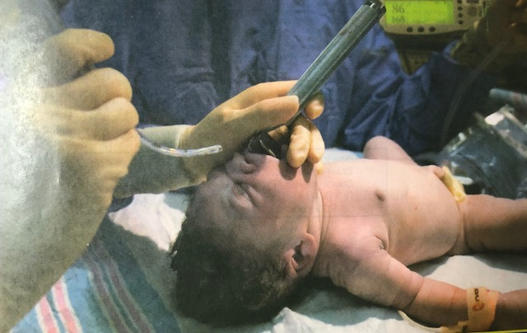
Alternative Airways
Endotracheal Tubes and Laryngeal Masks

Slide 2
Objectives
Indications for alternative airways
Selection and preparation of Equipment
How to use a laryngoscope
How to determine if endotracheal tube is in trachea
When to consider using a laryngeal mask for PPV
How to place a Laryngeal mask

Slide 3
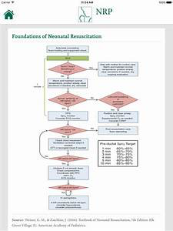

Slide 4
When should alternative airway be considered/recommended?
If PPV with a face mask does not result in clinical improvement
If PPV lasts more that a few minutes
Chest compressions are necessary
Suspected diaphragmatic hernia
Surfactant administration
Direct tracheal suction if airway obstructed with meconium or blood

Slide 5
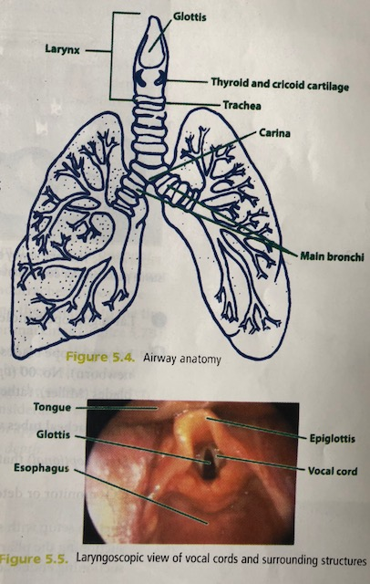
Anatomic Landmarks in Neonatal airway

Slide 6
Equipment needed for airway insertion
Laryngoscope handle
Laryngoscope blades: No 1, 0, 00
Endotracheal tubes: 2.5, 3.0, 3.5 mm
Stylet
CO2 monitor/detector
Suction
Tape, scissors
Meconium aspirator
Stethoscope
PPV device
Pulse oximeter
Laryngeal mask and 5ml syringe

Slide 7
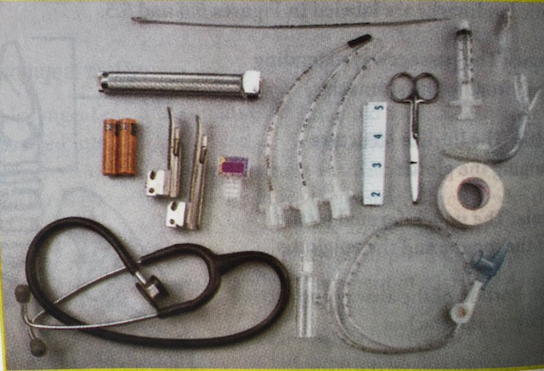

Slide 8
Endotracheal Intubation
Blade and tube size
Term newborns- No 1 blade
Preterm newborns- No 0 or 00 blade
Tube size
< 1Kg, or < 28 wks: 2.5 mm ID
1Kg – 2 Kg or 28-34 wks: 3.0 mm ID
> 2 Kg or > 34 wks: 3/5 mm ID
Suction equipment: catheter 5-8 F
PPV device
CO2 detector, stethoscope, measuring tape or insertion depth table, tape, scissors

Slide 9
Intubation – 30 seconds
Baby in sniffing position
Hold laryngoscope in left hand
Use right hand to open baby’s mouth
Insert laryngoscope and identify key landmarks
Lift laryngoscope in direction of handle
Insert endotracheal tube through vocal cords
Secure endotracheal tube, check depth
Attach PPV device and Ventilate
Chest rise? Equal lung air entry?
Check correct position with CO2 detector
CXR

Slide 10
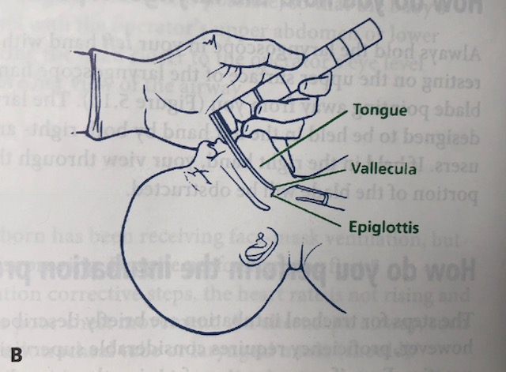
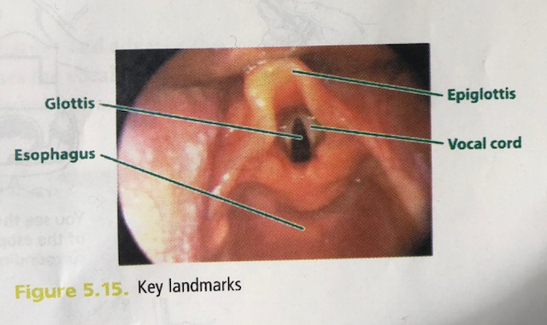
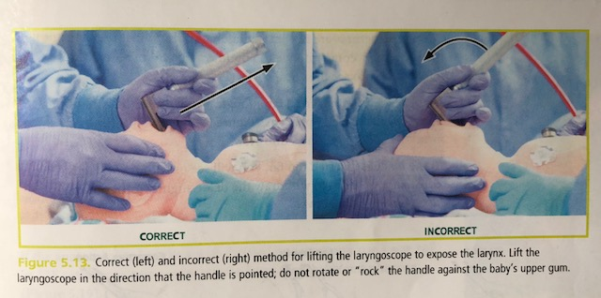

Slide 11
Check Ventilation after ET intubation
Chest rises?
Equal lung air entry?
Heart rate increasing?
C02 device turning color yellow?

Slide 12
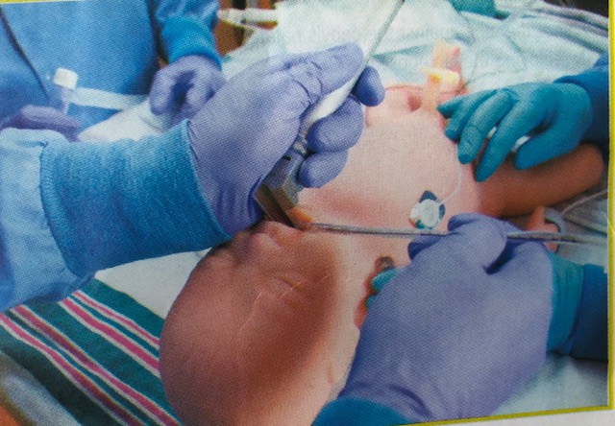

Slide 13
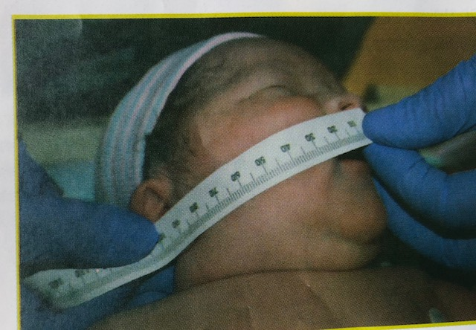
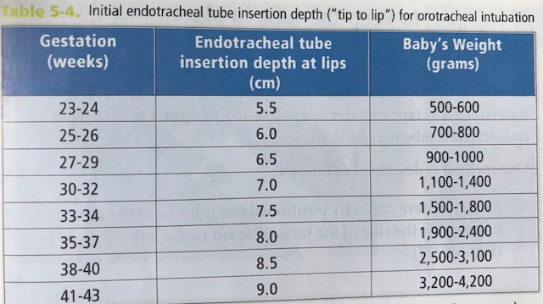

Slide 14
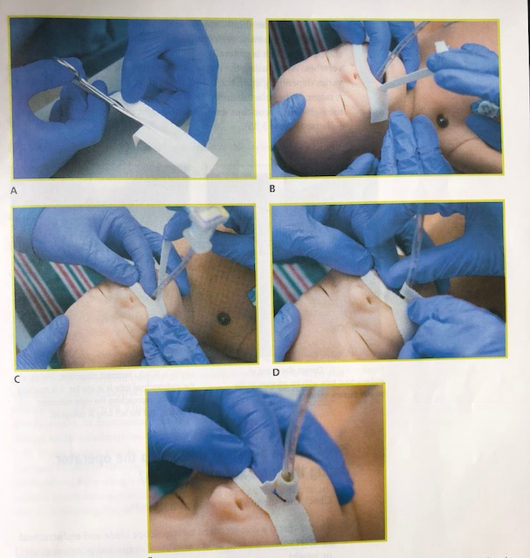

Slide 15
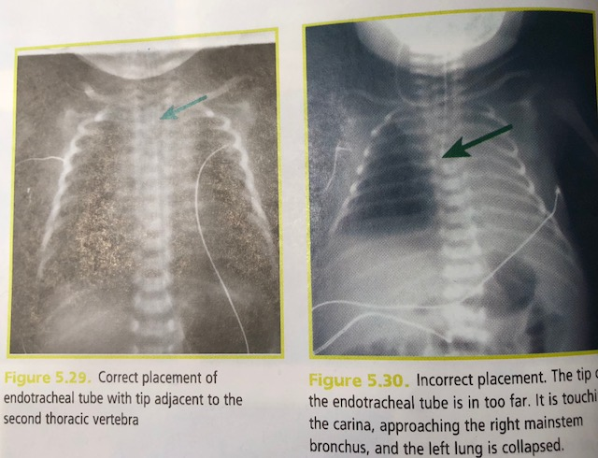

Slide 16
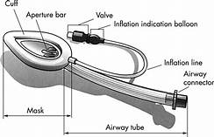
Laryngeal Mask Indications
Cannot ventilate
Cannot intubate
Congenital abnormalities mouth, lip, tongue, palate, neck
Small mandible, large tongue
Airway device that is alternative to face mask or endotracheal tube

Slide 17
Laryngeal mask (LMA) placement
Mask inserted into baby’s mouth and advanced until tip nearly reaches the esophagus
Inflate cuff
Mask covers the glottis (laryngeal opening) like a cap
Inflated cuff creates a seal against the hypopharynx
Airway tube can be connected to PPV device
Positive pressure is transmitted to baby’s trachea
Size 1 LMA for use in newborns < 5kg

Slide 18
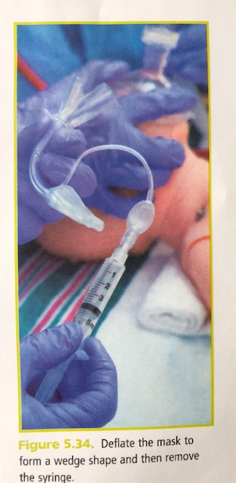
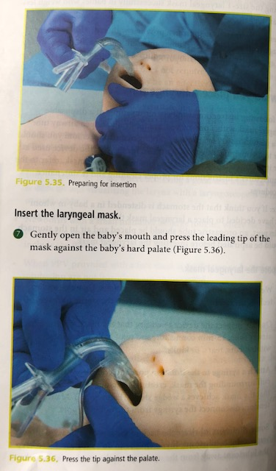

Slide 19
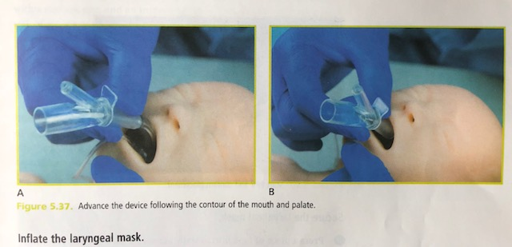
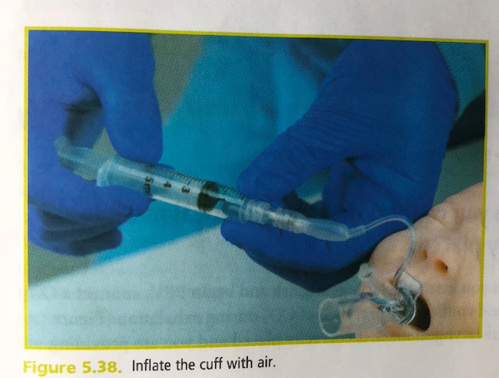

Slide 20
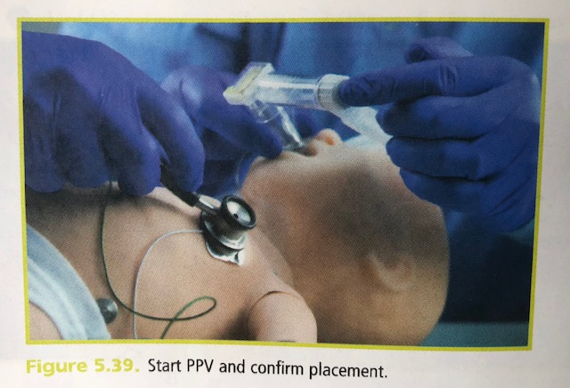
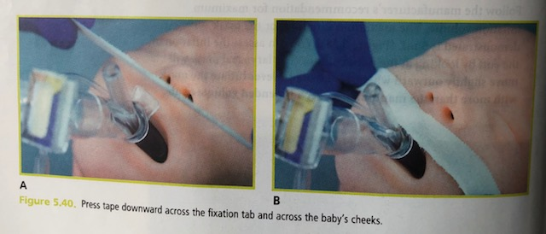

Slide 21
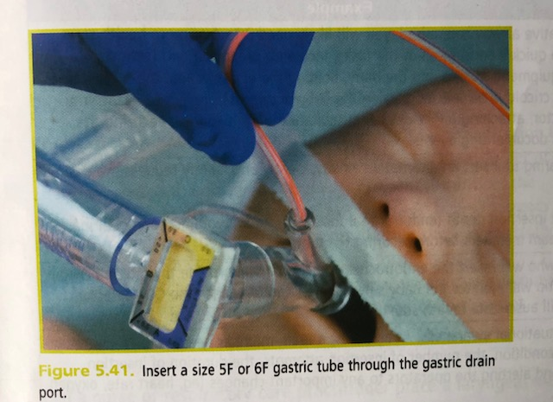

Slide 22
Check ventilation after LMA insertion
Chest rises?
Equal lung air entry?
Heart rate increasing?
C02 device turning color yellow?

Slide 23
Case scenario
Become familiar with ET and LMA equipment
Case

